Slide 1
PEO, PO, PSO,CO & Their Mapping for Out Come Based Education & Attainment Calculation
Prof. (Dr.) Saradindu Panda,
Principal, SurTech
PhD (Tech-NIT, Durgapur), M.Tech (JU), BE (BU)
Chairman, IEEE CASS Kolkata Section
MIEEE (CASS & EDS Chapter), MIET, MIEI, MCSTA, MIRED, MIAE
ORCID ID: 0000-0002-1945-4104
Web of Science Researcher ID: AAH-3588-2019
Email: principal_dsdec@jisgroup.org, saradindu.panda@nit.ac.in
Mob No-9051820335

Slide 2
WHAT IS OUTCOME BASED EDUCATION?
As per William G Spady, Outcome-Based Education means clearly focusing and organizing everything in an educational system around what is essential for all students to be able to do successfully at the end of their learning experiences.
This means starting with a clear picture of what is important for the students to be able to do then organizing curriculum, instruction & assessment to make sure this learning ultimately happens.
In the Outcome Based Education, “product defines process”.
It is the opposite of input-based education, where the the emphasis is on the teaching and the system is happy to accept whatever is the result.

Slide 3
WHY OBE?
1.International recognition and global employment opportunities.
2. More employable and innovative graduates with professional and soft skills, social responsibility and ethics.
3. Better visibility and reputation of the technical institution among stakeholders.
4. Improving the commitment and involvement of all the stakeholders.
5. Enabling graduates to excel in their profession and accomplish greater heights in their careers.
6. Preparing graduates for the leadership positions and challenging them and making them aware of the opportunities in the technology development.

Slide 4
ADVANTAGES OF OBE
Clarity: An explicit statement, of what the educational process aims to achieve, clarifies the curriculum for both students and teachers and provides a focus for teaching and learning.
Provision of a Framework: Outcome based education provides a robust framework for integration of the curriculum.
Guide for Assessment: the outcomes provide the framework for student’s examinations.
Facilitates Curriculum Evaluation: The outcomes provide a framework against which curriculum can be judged.

Slide 5
BENEFITS OF OBE FOR FACULTY MEMBERS
Faculty members are referred to as Change of Agents in OBE.
1. Teaching will become a far more creative and innovative career.
2. Faculty members will no longer feel the pressure of having to be the “source of all knowledge”.
3. Faculty members shape the thinking and vision of students towards a course.

Slide 6
WHEN THE STUDENT WILL LEARN WELL?
It is well established that students learn well when:
They are clear about what they should be able to do at the end of a course, what we are calling as Course Outcomes
Assessment is in alignment with what they are expected to do (assessment is in alignment with Course Outcomes).
Instructional activities are designed and conducted to facilitate the students to acquire and demonstrate what they are expected to do (alignment among instruction, assessment and Course Outcomes).

Slide 7
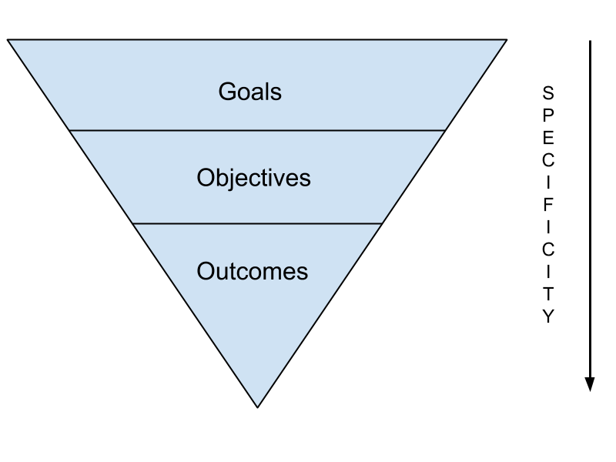
GOALS, OBJECTIVES & OUTCOMES
Goals
Goals are broad statements written from an instructor's or institution's perspective that give the general content and direction of a learning experience.
They generally describe what an instructor or program aims to do; i.e., “To develop self-motivated, creative & Ethical Skilled Engineers and Researchers to meet the Social Commitment.”

Slide 8
GOALS, OBJECTIVES & OUTCOMES
Objectives
Learning objectives are statements of what you intend to teach or cover in a learning experience.
They tend to be:
More specific than learning goals
Not necessarily observable nor measurable
Instructor-centered rather than student-centered
Useful in helping you formulate more specific learning outcomes

Slide 9
GOALS, OBJECTIVES & OUTCOMES
Objectives: Examples
Extensive learning of the basics in addition to intensive focusing on the most trivial areas of Electronics & Communication Engineering to sharpen in design and fabrication of electronic systems as per the requirement of industrial world.
Applying the engineering solutions for technical problems and inspiring towards perceiving post graduate programs and encourage towards R&D
Demonstrating the art of excellence in developing the effective communication skills in English and evolving the personality of the students suitable to the dynamic industrial needs.

Slide 10
GOALS, OBJECTIVES & OUTCOMES
Objectives: Examples
Adopting the characteristics of technical excellence through the systematically organized pedagogical practices in equipping the students with knowledge and practice for competing in the global competitive environment.
Motivating students to develop professional, ethical attitude, team building skills and multi-disciplinary approach to demonstrate the ideal behavioural qualities while leading the team for deriving maximum productivity.
Developing consciousness in the issue of social concerns and enabling students to upgrade their personality and experience through community services to have a meaningful linkage between the Institution and Society.

Slide 11
GOALS, OBJECTIVES & OUTCOMES
Outcomes
An outcome of an education is what the student should be able to do at the end of a program / course /instructional unit.
Outcome based education is an approach to education in which decisions about the curriculum are driven by the exit learning outcomes that the students should demonstrate at the end of the program / course.
Outcomes provide the basis for an effective interaction among stakeholders.

Slide 12
DIFFERENCE BETWEEN OBJECTIVES & OUTCOMES
OBJECTIVES | OUTCOMES
Objectives are intended results or consequences of instruction, curricula, programs, or activities. | Outcomes are achieved results or consequences of what was learned, i.e., evidence that learning took place.
Objectives are written more in terms of teaching intentions and typically indicate the subject content that the teacher(s) intends to cover. | Outcomes are more student-centered and describe what it is that the learner should learn.
Objectives are focused on specific types of performances that students are expected to demonstrate at the end of instruction. | Outcomes are statements that specify what learners will know or be able to do because of a learning activity, i.e., the outcomes that students must meet on the way to attaining a particular degree.

Slide 13
WHY WE WANT TO WRITE OUTCOMES?
Identifying the desired results of a learning experience is the first step of backward design. Learning outcomes are used for this purpose.
Learning outcomes help instructors...
describe to students what is expected of them
plan appropriate teaching strategies, materials and assessments
learn from and make changes to curriculum to improve student learning
assess how the outcomes of a single course align with larger outcomes for an entire program
Learning outcomes help students…
anticipate what they will gain from an educational experience
track their progress and know where they stand
know in advance how they'll be assessed

Slide 14
ELEMENTS OF EFFECTIVE OUTCOMES
Clearly written course-level and module-level outcomes are the foundation upon which effective courses are designed.
Outcomes inform both the way students are evaluated in a course and the way a course will be organized.
Effective learning outcomes are student-centered, measurable, concise, meaningful, achievable, and outcome-based (rather than task-based).
Student centered
Outcomes are phrased from the perspective of the student and are written in language that can be easily understood by them.
Measurable
Outcomes emphasize higher order thinking and are consistent with university, college, department, and program specific outcomes.

Slide 15
ELEMENTS OF EFFECTIVE OUTCOMES
Concise
Outcomes are written in short, succinct sentences.
Meaningful
Outcomes emphasize higher order thinking and are consistent with university, college, department, and program learning outcomes.
Achievable
The total number of outcomes is reasonable for this population of students and is achievable within the time available.
Outcome based.
Outcomes should specify the skills and knowledge students must demonstrate to prove mastery instead of focusing on the assignment format, such as a quiz or essay. Well-worded outcomes should remain flexible enough to accommodate a variety of formats for a corresponding assessment.

Slide 16
ELEMENTS OF EFFECTIVE OUTCOMES
Examples of Common Learning Outcome Problems and Solutions
Not Student-Centered Different theories of personality development will be explored through lectures, readings, and assignments. | Student-Centered Students will name each theory of personality development and describe the key characteristics that distinguish each theory.
Not Measurable Students will understand symbolism. | Measurable Students will be able to identify examples of symbolism in short stories and incorporate symbolism in their own writing.
Not Clear Students will be able to analyze American history. | Clear Students will be able to analyze how American foreign policy history relates to current trends in American foreign policy.

Slide 17
ELEMENTS OF EFFECTIVE OUTCOMES
Examples of Common Learning Outcome Problems and Solutions
Not Concise Students will analyze American foreign policy, from 18th-century diplomatic relations with Europe to the Monroe Doctrine, considering the ways in which shifts from expansionism and Manifest Destiny to isolationism and protectionism impacted relations with neighbouring nations and Native Americans. | Concise Students will be able to identify how changes in American foreign policy during the 18th and 19th centuries impacted relations with neighboring nations and Native Americans.
Task-Based (Inflexible) Students will be able to demonstrate on a mannequin the four steps to administer CPR. | Outcome-Based (Flexible) Students will be able to demonstrate the four steps used to administer CPR.

Slide 18
LEVELS OF OUTCOMES
PROGRAM EDUCATIONAL OBJECTIVES: PEOs
PEOs are broad statements that describe the carrier and professional accomplishments in four to five years after graduation that the program is preparing graduates to achieve.
Sample: Solve problems of social relevance applying the knowledge of Electronics & Communication Engineering, and/or pursue higher education & research

Slide 19
LEVELS OF OUTCOMES
PROGRAM OUTCOMES: POs
POs are statements that describe what the students graduating from engineering programs should be able to do at the time of graduation.
Sample:
PO3 - design development of solutions: Design solutions for complex engineering problems and design system components or processes that meet the specified needs, with appropriate consideration for the public health and safety and the cultural, societal, and environmental considerations.

Slide 20
LEVELS OF OUTCOMES
PROGRAM SPECIFIC OUTCOMES: PSOs
PSOs are statements that describe what the graduates of a specific engineering program should be able to do at the time of graduation.
Sample:
PSO2: Ability to design the systems of Electronics & Communication Engineering using advanced hardware and software tools with analytical skills to achieve the Societal needs.

Slide 21
LEVELS OF OUTCOMES
COURSE OUTCOMES: COs
COs are statements that describe what students should be able to do at the end of a course.
Sample:
Student will be able to-
understand the divide and conquer strategy for designing algorithms, including Merge sort and Quick sort.

Slide 22
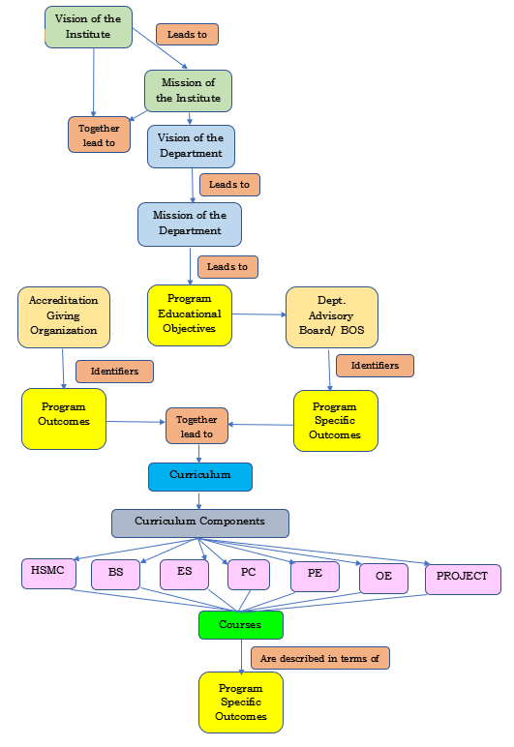
OBE FRAMEWORK

Slide 23
LEARNING TAXONOMIES: Bloom Taxonomy
There are several taxonomies reported in the literature, we have the Bloom's taxonomy, SOLO taxonomy, taxonomies is due to Fink, Gagne, Marazano and Kendall, etc.
Benjamin Bloom was working along with a group of measurement experts in the early 1950s on the development of a taxonomy of learning.
In 1956, the group produced “taxonomy of educational objectives, the classification of educational goals Handbook cognitive domain”.
After such a similar process of discussions, involving several experts, a major revision was proposed in 2001.
It was edited by Anderson, Krathwhol et.al. and the book, which has now become very popular, is titled as “A Taxonomy of Learning, Teaching and Assessing: A Revision of Bloom's Taxonomy of Educational Objectives”.

Slide 24


Bloom Taxonomy: DOMAINS OF LEARNING
As per Bloom’s taxonomy, all learning can be broadly classified in three major domains of learning: Cognitive domain learning, Psychomotor domain learning, Affective domain learning
Cognitive domain learning:deals with the person's ability to process and utilize information in a meaningful way. Involves Thinking & Experiencing.

Slide 25


Bloom Taxonomy: DOMAINS OF LEARNING
Psychomotor domain learning: involves manipulative our physical skills. Involves Action, practical & Physical.
Example: Giving Bicycle Kick, Sports activities etc

Slide 26


Bloom Taxonomy: DOMAINS OF LEARNING
Affective domain learning: relates to attitudes and feelings that result from or influence the learning process.
. Involves Feelings/Attitudes.

Slide 27



Bloom Taxonomy: DOMAINS OF LEARNING
Integrated Domain:
Changing Domain:

Slide 28
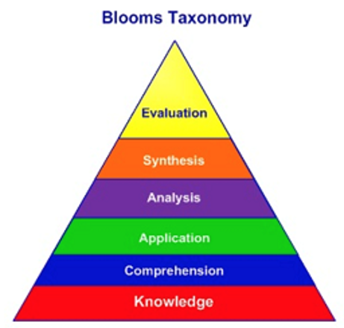
LEARNING TAXONOMIES: Bloom’s Taxonomy
The original taxonomy had six categories in the cognitive domain: Knowledge, Comprehension, Application, Analysis, Synthesis, Evaluation.
The categories were ordered from simple to complex, and from concrete to abstract.
Knowledge was considered as simplest of all, more complex was comprehension, and still more complex was application and so on.
The highest complexity was at the level of evaluation.

Slide 29
LEARNING TAXONOMIES: Bloom’s Taxonomy
All these categories except application had several sub-categories.
The knowledge category had the maximum number of sub-categories: knowledge of terminology, specific facts, conventions, trends and sequences, classifications and categories, criteria, methodology, universals and abstractions in a field principles and generalizations, theories and structures.

Slide 30
LEARNING TAXONOMIES: Bloom’s Taxonomy
Knowledge: Requirements or instructions that trigger typical knowledge-seeking or identifiable activities.
Comprehension: This level refers to the student’s ability to understand what is being said, to be able to present in his or her way the content and to understand the conclusions that follow directly from content, claims or results.
Application: This is about the ability to use some abstractions in specific situations, that is, to solve problems using learned concepts, ideas, rules, or procedures.

Slide 31
LEARNING TAXONOMIES: Bloom’s Taxonomy
Analysis: This level of educational goals is based on logical thinking. To achieve the objectives appropriate to the level of analysis
Synthesis: This level of goal implies the ability to combine known elements and create a new whole, model, or structure that did not exist before. The core of achieving this category of goals lies in creative thinking. Students will perform appropriate activities aimed at achieving the goals
Evaluation: The objectives at the evaluation level are standards that can be set by the learner; it is their own personal interpretation.

Slide 32
LEARNING TAXONOMIES: Revised Bloom’s Taxonomy
Knowledge’s extensive subcategories represented aspects of subject matter (This represents a kind of a noun or noun-phrase)
Definition given to knowledge stated that the student was expected to be able to recall or recognize knowledge (verb aspect or verb-phrase).
This dual nature of knowledge category made it different from other taxonomic categories.
The other categories, comprehension, application, analysis, synthesis, evaluation, they do not have this dual nature.
So, this anomaly was resolved in the revised Bloom's taxonomy.
The noun was the basis for the knowledge dimension, the verb was the basis for the cognitive process dimension.
The revised Bloom's Taxonomy is two dimensional in nature.

Slide 33
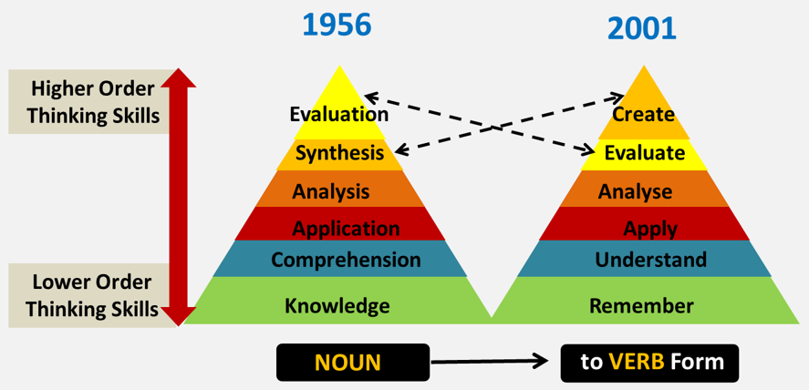
LEARNING TAXONOMIES: Revised Bloom’s Taxonomy
Cognitive processes of revised Bloom’s taxonomy are 6 number hierarchically organized, Remember, Understand, Apply, Analyse, Evaluate and Create.
Renaming: The Verb aspect of original Knowledge category was named “Remember”. “Comprehend” renamed as “Understand”. “Synthesis” was changed to “Create”.

Slide 34
LEARNING TAXONOMIES: Revised Bloom’s Taxonomy
‘Application, analysis and evaluation’ were retained from the original taxonomy, but, what changed to the verb form ‘Apply, analyze and evaluate’.
There was a change made with respect to the highest two categories. Create was made higher in the hierarchy than evaluate in Revised Bloom’s Taxonomy.

Slide 35
LEARNING TAXONOMIES: Revised Bloom’s Taxonomy Cognitive Domain
Category or 'level' | Behavior descriptions | Examples of activity to be trained, or demonstration and evidence to be measured | 'Key words' (verbs which describe the activity to be trained or measured at each level)
Remembering | Recall or recognize information | Multiple-choice test, recount facts or statistics, recall a process, rules, definitions; quote law or procedure | Arrange, define, describe, label, list, memorize, recognize, relate, reproduce, select, state
2. Understanding | Understand meaning, re-state data in one's own words, interpret, extrapolate, translate | Explain or interpret meaning from a given scenario or statement, suggest treatment, reaction or solution to given problem, create examples or metaphors | Explain, reiterate, reword, critique, classify, summarize, illustrate, translate, review, report, discuss, re-write, estimate, interpret, theorize, paraphrase, reference, example

Slide 36
LEARNING TAXONOMIES: Revised Bloom’s Taxonomy Cognitive Domain
Category or 'level' | Behavior descriptions | Examples of activity to be trained, or demonstration and evidence to be measured | 'Key words' (verbs which describe the activity to be trained or measured at each level)
3. Applying | Use or apply knowledge, put theory into practice, use knowledge in response to real circumstances | Put a theory into practical effect, demonstrate, solve a problem, manage an activity | Use, apply, discover, manage, execute, solve, produce, implement, construct, change, prepare, conduct, perform, react, respond, role-play
4. Analyzing | Interpret elements, organizational principles, structure, construction, internal relationships; quality, reliability of individual components | Identify constituent parts and functions of a process or concept, or de-construct a methodology or process, making qualitative assessment of elements, relationships, values and effects; measure requirements or needs | Analyze, break down, catalogue, compare, quantify, measure, test, examine, experiment, relate, graph, diagram, plot, extrapolate, value, divide

Slide 37
LEARNING TAXONOMIES: Revised Bloom’s Taxonomy Cognitive Domain
Category or 'level' | Behavior descriptions | Examples of activity to be trained, or demonstration and evidence to be measured | 'Key words' (verbs which describe the activity to be trained or measured at each level)
5. Evaluating | Assess effectiveness of whole concepts, in relation to values, outputs, efficacy, viability; critical thinking, strategic comparison and review; judgment relating to external criteria | Review strategic options or plans in terms of efficacy, return on investment or cost-effectiveness, practicability; assess sustainability; perform a SWOT analysis in relation to alternatives; produce a financial justification for a proposition or venture, calculate the effects of a plan or strategy; perform a detailed risk analysis with recommendations and justifications | Review, justify, assess, present a case for, defend, report on, investigate, direct, appraise, argue, project-manage

Slide 38
LEARNING TAXONOMIES: Revised Bloom’s Taxonomy Cognitive Domain
Category or 'level' | Behavior descriptions | Examples of activity to be trained, or demonstration and evidence to be measured | 'Key words' (verbs which describe the activity to be trained or measured at each level)
6. Creating | Develop new unique structures, systems, models, approaches, ideas; creative thinking, operations | Develop plans or procedures, design solutions, integrate methods, resources, ideas, parts; create teams or new approaches, write protocols & contingencies | Develop, plan, build, create, design, organize, revise, formulate, propose, establish, assemble, integrate, re-arrange, modify

Slide 39
LEARNING TAXONOMIES: Revised Bloom’s Taxonomy Affective Domain
Category or 'level' | Behavior descriptions | Examples of activity to be trained, or demonstration and evidence to be measured | 'Key words' (verbs which describe the activity to be trained or measured at each level)
Receiving | Open to experience, willing to hear | Listen to teacher or trainer, take interest in session or learning experience, take notes, turn up, make time for learning experience, participate passively | Ask, listen, focus, attend, take part, discuss, acknowledge, hear, be open to, retain, follow, concentrate, read, do, feel
2. Responding | React and participate actively | Participate actively in group discussion, active participation in activity, interest in outcomes, enthusiasm for action, question and probe ideas, suggest interpretation | React, respond, seek clarification, interpret, clarify, provide other references and examples, contribute, question, present, cite, become animated or excited, help team, write, perform

Slide 40
LEARNING TAXONOMIES: Revised Bloom’s Taxonomy Affective Domain
Category or 'level' | Behavior descriptions | Examples of activity to be trained, or demonstration and evidence to be measured | 'Key words' (verbs which describe the activity to be trained or measured at each level)
3. Valuing | Attach values and express personal opinions | Decide worth and relevance of ideas, experiences; accept or commit to stance or action | Argue, challenge, debate, refute, confront, justify, persuade, criticize,
4. Organizing or Conceptualizing Values | Reconcile internal conflicts; develop value system | Qualify and quantify personal views, state personal position and reasons, state beliefs | Build, develop, formulate, defend, modify, relate, prioritize, reconcile, contrast, arrange, compare
5. Internalizing Values | Adopt belief system and philosophy | Self-reliant; behave consistently with personal value set | Act, display, influence, solve, practice,

Slide 41
LEARNING TAXONOMIES: Revised Bloom’s Taxonomy Psychomotor Domain
Category or 'level' | Behavior descriptions | Examples of activity to be trained, or demonstration and evidence to be measured | 'Key words' (verbs which describe the activity to be trained or measured at each level)
1. Imitation | Copy action of another; observe and replicate | Watch teacher or trainer and repeat action, process or activity | Copy, follow, replicate, repeat, adhere, attempt, reproduce, organize, sketch, duplicate
2. Manipulation | Reproduce activity from instruction or memory | Carry out task from written or verbal instruction | Re-create, build, perform, execute, implement, acquire, conduct, operate
3. Precision | Execute skill reliably, independent of help, activity is quick, smooth, and accurate | Perform a task or activity with expertise and to high quality without assistance or instruction; able to demonstrate an activity to other learners | Demonstrate, complete, show, perfect, calibrate, control, achieve, accomplish, master, refine

Slide 42
LEARNING TAXONOMIES: Revised Bloom’s Taxonomy Psychomotor Domain
Category or 'level' | Behavior descriptions | Examples of activity to be trained, or demonstration and evidence to be measured | 'Key words' (verbs which describe the activity to be trained or measured at each level)
4. Articulation | Adapt and integrate expertise to satisfy a new context or task | Relate and combine associated activities to develop methods to meet varying, novel requirements | Solve, adapt, combine, coordinate, revise, integrate, adapt, develop, formulate, modify, master
5. Naturalization | Instinctive, effortless, unconscious mastery of activity and related skills at strategic level | Define aim, approach and strategy for use of activities to meet strategic need | Construct, compose, create, design, specify, manage, invent, project-manage, originate

Slide 43
Revised Bloom’s Taxonomy: Remembering
Behavioral Description: Recall or recognize information
Sub Category
Recognizing- essentially means that the solutions are presented, and the learner can recognize the correct response from the presented solutions.
Recalling-is recalling from long term memory based on certain key word that is provided to the learner.
Examples of activity to be trained, or demonstration and evidence to be measured :
Multiple-choice test, recount facts or statistics, recall a process, rules, definitions; quote law or procedure
Action Verb:
Arrange, define, describe, label, list, memorize, recognize, relate, reproduce, select, state

Slide 44
Revised Bloom’s Taxonomy: Understanding
Behavioral Description:
Understand meaning, re-state data in one's own words, interpret, extrapolate, translate
Sub Category
Interpreting: changing from one expression to another; Translating
Exemplifying: giving a specific example or instance of a general concept or principle
[Example: Providing a specific example of a viscous fluid that we encounter in daily life]
Classifying: recognizing that a specific instance; complimentary process of Exemplifying.
Summarizing: abstracting, generalizing

Slide 45
Revised Bloom’s Taxonomy: Understanding
Sub Category
Inferring: abstracting a concept or principle from a set of examples. A related process is to use this inferred principle to create a new instance. An example of executing a cognitive process associated with apply. Inferring and executing are often used together on cognitive tasks.
Comparing: detecting similarities and differences between two or more ideas, concepts, events, etc. This can contribute to reasoning by analogy also.
Explaining: A student is able to construct and use a cause-and-effect model of a system to explain a phenomenon or to determine how a change in one part of the system affects the other parts. The model may be derived from a formal theory, or it may be an empirical model. A variety of assessment strategies are possible with respect to this subprocess. Assessment could include, reasoning, troubleshooting, redesigning and predicting

Slide 46
Revised Bloom’s Taxonomy: Understanding
Examples of activity to be trained, or demonstration and evidence to be measured :
Explain or interpret meaning from a given scenario or statement, suggest treatment, reaction or solution to given problem, create examples or metaphors
Action Verb:
interpreting: translate, paraphrase, represent, clarify; re-write, interpret, example
exemplifying: illustrate, instantiate;
classifying: categorize, subsume; classify,
summarizing: generalize, abstract; summarize, theorize,
inferring: find a pattern, extrapolate, predict; report, interpolate
comparing: contrast, compare, match, distinguish, critique, differentiate; reword, review, reference, mapping
explaining: construct a model, explain, reiterate, discuss, estimate

Slide 47
Revised Bloom’s Taxonomy: Applying
Behavioral Description:
Use or apply knowledge, put theory into practice, use knowledge in response to real circumstances
Sub-Category:
Executing: solving a task for which the right procedure is already known, this produces clear solution. Routinely carry out the procedure, clearly indicated in the problem itself or the context.
Implementing: implies solving a problem that has features which have not been encountered in that form earlier. Student must select a procedure, may have to even modify it, to solve the task.
Examples of activity to be trained, or demonstration and evidence to be measured :
Put a theory into practical effect, demonstrate, solve a problem, manage an activity.
Action Verb:
Use, apply, discover, manage, execute, solve, produce, implement, construct, change, prepare, conduct, perform, react, respond, role-play

Slide 48
Revised Bloom’s Taxonomy: Analysing
Behavioral Description:
Interpret elements, organizational principles, structure, construction, internal relationships; quality, reliability of individual components
Sub-Category:
Differentiating: distinguishing relevant parts or important parts from unimportant parts of the presented material. different from comparing which occurs at Understand level in the sense that the larger context is used to determine relevance or importance.
Organizing: building systematic and coherent connections among pieces of presented information.
Attributing: determining a point of view, bias, values of the underlying presented material.
Action Verb:
Analyze, break down, catalogue, compare, quantify, measure, test, examine, experiment, relate, graph, diagram, plot, extrapolate, value, divide, discriminate, focus, distinguish, select, structure, integrate, outline, deconstruct
Examples of activity to be trained, or demonstration and evidence to be measured :
Identify constituent parts and functions of a process or concept, or de-construct a methodology or process, making qualitative assessment of elements, relationships, values and effects; measure requirements or needs

Slide 49
Revised Bloom’s Taxonomy: Evaluating
Behavioral Description:
Assess effectiveness of whole concepts, in relation to values, outputs, efficacy, viability; critical thinking, strategic comparison and review; judgment relating to external criteria
Sub-Category:
Checking: judgment about consistency essentially that would be the internal consistency of the given material;
Critiquing: judgments based on criteria and standards which are generally external.
Examples of activity to be trained, or demonstration and evidence to be measured :
Review strategic options or plans in terms of efficacy, return on investment or cost-effectiveness, practicability; assess sustainability; perform a SWOT analysis in relation to alternatives; produce a financial justification for a proposition or venture, calculate the effects of a plan or strategy; perform a detailed risk analysis with recommendations and justifications
Action Verb:
Review, justify, assess, present a case for, defend, report on, investigate, direct, appraise, argue, manage, monitor, coordinate, test, detect, accuracy, adequacy, clarity, correctness, reliability, validity

Slide 50
Revised Bloom’s Taxonomy: Creating
Behavioral Description:
Develop new unique structures, systems, models, approaches, ideas; creative thinking, operations
Sub-Category:
Generating: the divergent phase where the students try to come out with multiple solutions to the given problem, multiple representations of the problem, alternative solutions to the problem, alternative perspectives to the problem.
Planning: the start of the convergent phase. Often implicitly carried out. Here among the alternatives generated in the earlier sub-process, one of the alternatives is picked up as the preferred solution strategy. It is devising a plan for solving the problem.
Producing: where the students carry out the plan for solving the given problem. It is also known as constructing. The solution which has been selected during the planning phase is implemented during the producing phase. It is also called as constructing

Slide 51
Revised Bloom’s Taxonomy: Creating
Examples of activity to be trained, or demonstration and evidence to be measured :
Develop plans or procedures, design solutions, integrate methods, resources, ideas, parts; create teams or new approaches, write protocols & contingencies
Action Verb:
Develop, plan, build, create, design, organize, revise, formulate, propose, establish, assemble, integrate, re-arrange, modify

Slide 52
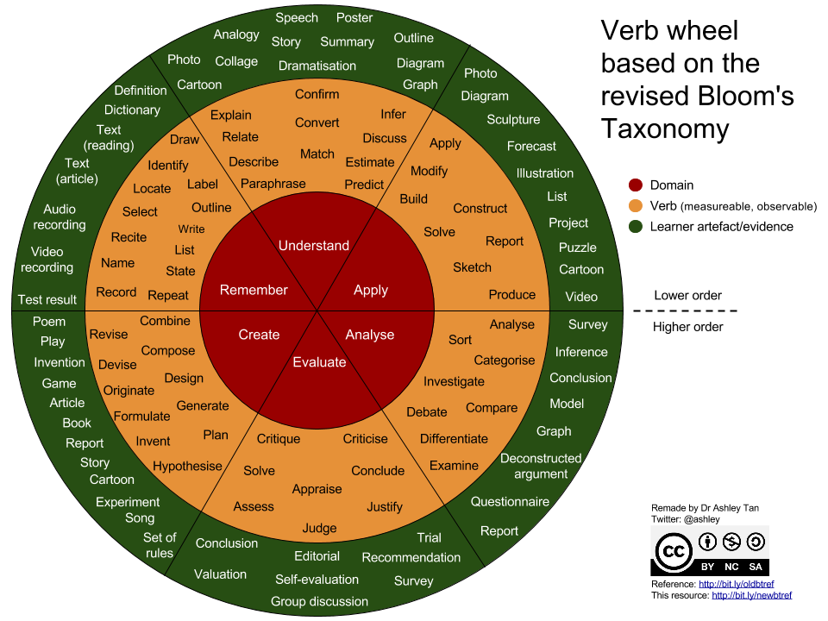
Revised Bloom’s Taxonomy: Action Verbs with activities

Slide 53
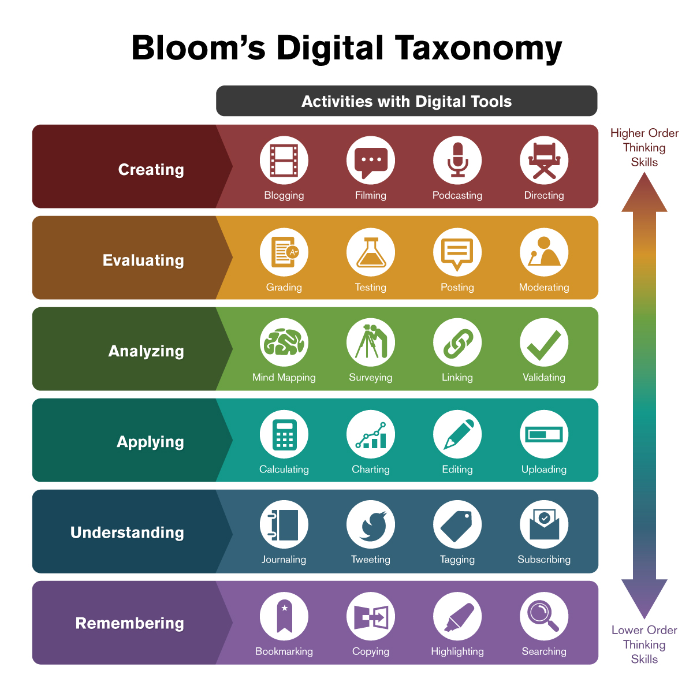
Revised Bloom’s Digital: Activities with Digital Tools

Slide 54
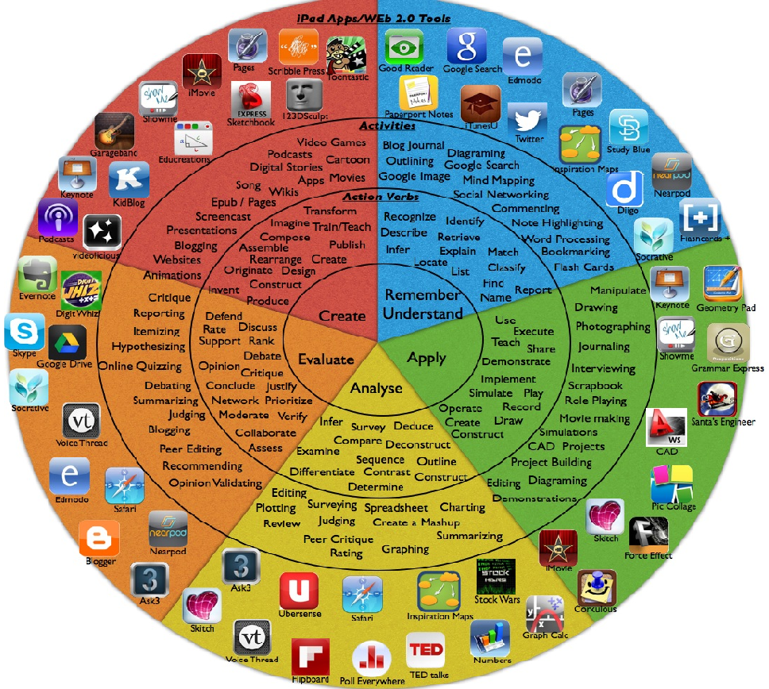
Revised Bloom’s Taxonomy: Action Verbs with Online Activities

Slide 55
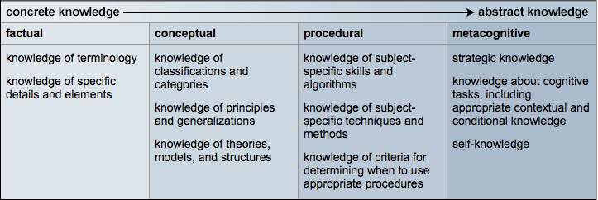
LEARNING TAXONOMIES: Revised Bloom’s Taxonomy
The knowledge dimensions were represented in the Four categories in the revised taxonomy:
factual knowledge, conceptual knowledge, procedural knowledge, and metacognitive knowledge.

Slide 56
LEARNING TAXONOMIES: Revised Bloom’s Taxonomy
Factual Knowledge :
Factual Knowledge is fairly easy to understand, that is basic elements students must know if they are to be acquainted with the discipline or solve any of the problems in it. This knowledge exists at a relatively low level of abstraction.
Samples of Factual Knowledge:
Terminology: Signal-to-noise ratio, low pass filter, VCVS, CCCS power factor, etc
Specific details:
The Power supply frequency in India is 50 hertz.
Semiconductor devices fail above 120 degrees.
Ball grid array packaging can provide for more than 200 input-output pins.
TI and analog devices are two semiconductor manufacturers making a wide variety of analog ICs.

Slide 57
LEARNING TAXONOMIES: Revised Bloom’s Taxonomy
Conceptual Knowledge :
A concept denotes all the entities, phenomena and/or relations in a given category or class by using definitions.
Concepts are abstract in that they omit the differences of things in their extension.
Concepts are also basic elements of propositions, much the same way, a word is the basic semantic element of a sentence.
It also includes, knowledge of categories, classifications and the relationship between and among them, schemas, mental models or implicit or explicit theories.

Slide 58
LEARNING TAXONOMIES: Revised Bloom’s Taxonomy
Conceptual Knowledge :
Schemas, models, and theories represent:
how a particular subject matter is organized and structured.
how the different parts or bits of information are interconnected and interrelated in a more systematic manner.
How these parts function together.
Samples of Conceptual Knowledge:
Force, acceleration, velocity, mass, voltage, current, temperature, entropy, stress, strain, signal to noise ratio, Kirchhoff’s laws, Newton's law, one law of motion, laws of thermodynamics, etc

Slide 59
LEARNING TAXONOMIES: Revised Bloom’s Taxonomy
Procedural Knowledge :
It is the “knowledge of how” to do something.
It often takes the form of a series or sequence of steps to be followed.
It includes knowledge of skills, algorithms, techniques, and methods collectively known as procedures.
It also includes knowledge of the criteria used to determine when to use various procedures.
It is specific or germane to the particular subject matter or academic disciplines.
Samples of Conceptual Knowledge:
Solving a first-order differential equation; solving a matrix differential equation; preparing a truth-table from a logic expression; drawing a Bode plot or designing a filter as per specifications

Slide 60
LEARNING TAXONOMIES: Revised Bloom’s Taxonomy
Metacognitive Knowledge :
The word ‘meta’ of cognition itself says it is somewhat different from cognition.
Metacognition is thinking about one’s own thinking - that is what Metacognition, and this ability is also very important to individuals.
This is the ability to assess our own skills, knowledge or learning.
The formal definition has given by Stephen Chew, ‘a person’s awareness of his/her own level of knowledge and thought processes’.
Metacognitive ability affects:
How well and how long a student studies
How much and how deeply students learn
Knowledge about cognition in general as well as awareness of knowledge about one's own cognition.

Slide 61
LEARNING TAXONOMIES: Revised Bloom’s Taxonomy
Why should we be concerned about Metacognition? High performing students generally have better metacognitive skills.
Weaker students typically have poor metacognition besides other things
Poor metacognition is a big part of incompetence
Student will metacognition skill will often:
Shorten their study time prematurely thinking that they have mastered course material that they barely know
Grossly overconfident in their level of understanding
Underestimate or overestimate their performance in tests, make poor study decisions

Slide 62
LEARNING TAXONOMIES: Revised Bloom’s Taxonomy
Action should be taken for Metacognitive Knowledge:
Assessing the task at hand
Evaluating one’s own strengths and weaknesses
Planning an appropriate approach;
Applying strategies and monitoring one’s own performance
Reflecting and adjusting one’s own approach
Beliefs about intelligence and learning

Slide 63
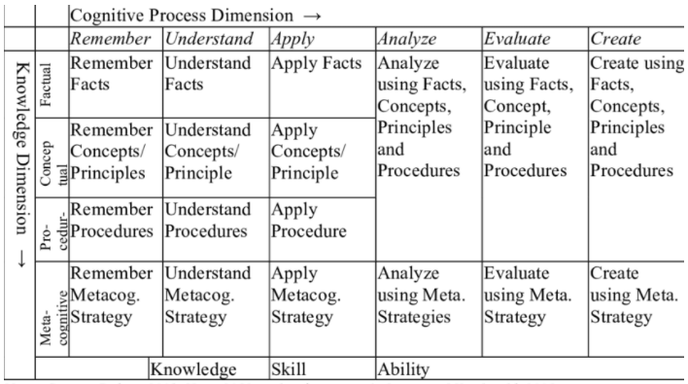
LEARNING TAXONOMIES: Revised Bloom’s Taxonomy

Slide 64
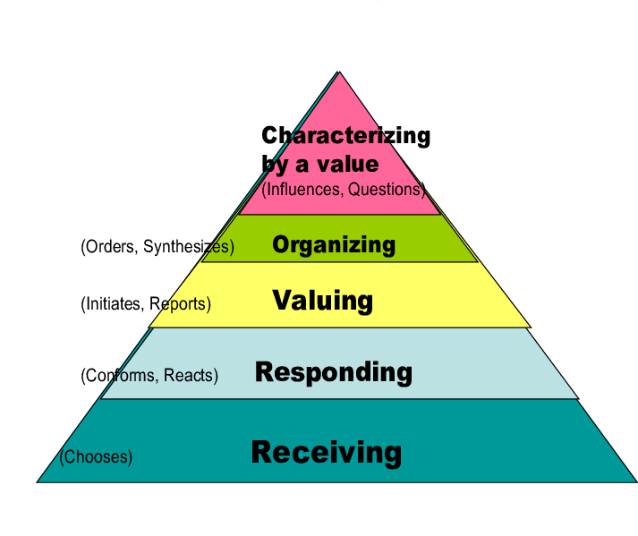
Bloom’s Taxonomy:
Affective Domain - (emotions - attitude - 'feel')
Bloom's Taxonomy second domain, the Affective Domain, was detailed by Bloom, Krathwhol and Masia (1964, Taxonomy of Educational Objectives: Vol. II, The Affective Domain.
Bloom's theory advocates this structure and sequence for developing attitude - also now commonly expressed in the modern field of personal development as 'beliefs’.
As with the other domains, the Affective Domain detail provides a framework for teaching, training, assessing and evaluating the effectiveness of training and lesson design and delivery, and also the retention by and affect upon the learner or trainee.

Slide 65
Bloom’s Taxonomy:
Affective Domain -Receiving
Behavioral Description:
Open to experience, willing to hear
Examples of activity to be trained, or demonstration and evidence to be measured :
Listen to teacher or trainer, take interest in session or learning experience, take notes, turn up, make time for learning experience, participate passively
Action Verb:
Ask, listen, focus, attend, take part, discuss, acknowledge, hear, be open to, retain, follow, concentrate, read, do, feel

Slide 66
Bloom’s Taxonomy:
Affective Domain -Responding
Behavioral Description:
React and participate actively
Examples of activity to be trained, or demonstration and evidence to be measured :
Participate actively in group discussion, active participation in activity, interest in outcomes, enthusiasm for action, question and probe ideas, suggest interpretation
Action Verb:
React, respond, seek clarification, interpret, clarify, provide other references and examples, contribute, question, present, cite, become animated or excited, help team, write, perform

Slide 67
Bloom’s Taxonomy:
Affective Domain -Valuing
Behavioral Description:
Attach values and express personal opinions
Examples of activity to be trained, or demonstration and evidence to be measured :
Decide worth and relevance of ideas, experiences; accept or commit to particular stance or action
Action Verb:
Argue, challenge, debate, refute, confront, justify, persuade, criticize

Slide 68
Bloom’s Taxonomy:
Affective Domain -Organizing or Conceptualizing Values
Behavioral Description:
Reconcile internal conflicts; develop value system
Examples of activity to be trained, or demonstration and evidence to be measured :
Qualify and quantify personal views, state personal position and reasons, state beliefs
Action Verb:
Build, develop, formulate, defend, modify, relate, prioritize, reconcile, contrast, arrange, compare

Slide 69
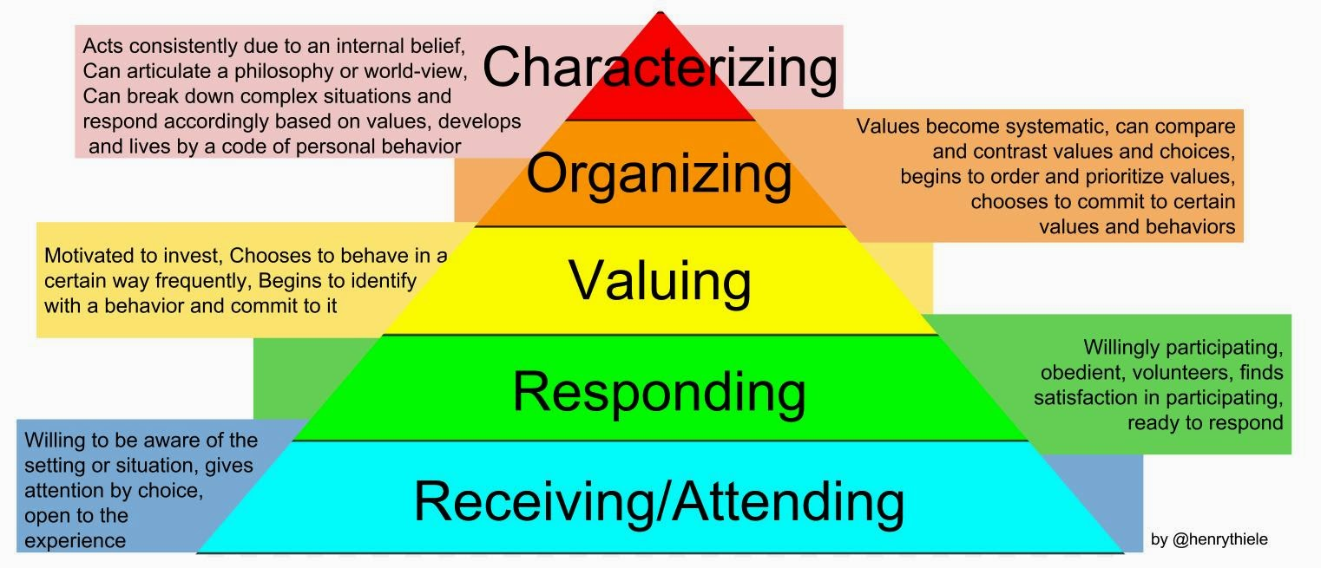
Bloom’s Taxonomy:
Affective Domain

Slide 70
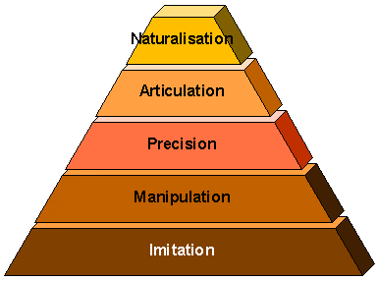
Bloom’s Taxonomy:
Psychomotor Domain - (physical - skills - 'do')
The Psychomotor Domain was established to address skills development relating to the physical dimensions of accomplishing a task.
Because 'motor' skills extend beyond the originally traditionally imagined manual and physical skills, always consider using this domain, even if you think your environment is covered adequately by the Cognitive and Affective Domains

Slide 71
Bloom’s Taxonomy:
Psychomotor Domain- Imitation
Behavioral Description:
Copy action of another; observe and replicate
Examples of activity to be trained, or demonstration and evidence to be measured :
Watch teacher or trainer and repeat action, process or activity
Action Verb:
Copy, follow, replicate, repeat, adhere, attempt, reproduce, organize, sketch, duplicate

Slide 72
Bloom’s Taxonomy:
Psychomotor Domain- Manipulation
Behavioral Description:
Reproduce activity from instruction or memory
Examples of activity to be trained, or demonstration and evidence to be measured :
Carry out task from written or verbal instruction
Action Verb:
Re-create, build, perform, execute, implement, acquire, conduct, operate

Slide 73
Bloom’s Taxonomy:
Psychomotor Domain- Precision
Behavioral Description:
Execute skill reliably, independent of help, activity is quick, smooth, and accurate
Examples of activity to be trained, or demonstration and evidence to be measured :
Perform a task or activity with expertise and to high quality without assistance or instruction; able to demonstrate an activity to other learners
Action Verb:
Demonstrate, complete, show, perfect, calibrate, control, achieve, accomplish, master, refine

Slide 74
Bloom’s Taxonomy:
Psychomotor Domain- Articulation
Behavioral Description:
Adapt and integrate expertise to satisfy a new context or task
Examples of activity to be trained, or demonstration and evidence to be measured :
Relate and combine associated activities to develop methods to meet varying, novel requirements
Action Verb:
Solve, adapt, combine, coordinate, revise, integrate, adapt, develop, formulate, modify, master

Slide 75
Bloom’s Taxonomy:
Psychomotor Domain- Naturalization
Behavioral Description:
Instinctive, effortless, unconscious mastery of activity and related skills at strategic level
Examples of activity to be trained, or demonstration and evidence to be measured :
Define aim, approach and strategy for use of activities to meet strategic need
Action Verb:
Construct, compose, create, design, specify, manage, invent, project-manage, originate

Slide 76
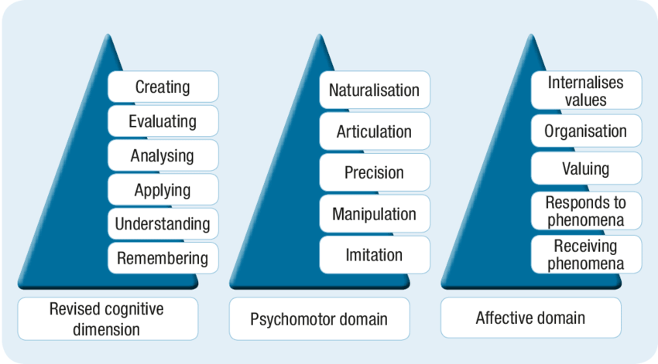
Bloom’s Taxonomy

Slide 77
Bloom’s Taxonomy: Cognitive Domain
Category or 'level' | Behavior descriptions | Examples of activity to be trained, or demonstration and evidence to be measured | 'Key words' (verbs which describe the activity to be trained or measured at each level)
Remembering | Recall or recognize information | Multiple-choice test, recount facts or statistics, recall a process, rules, definitions; quote law or procedure | Arrange, define, describe, label, list, memorize, recognize, relate, reproduce, select, state
Understanding | Understand meaning, re-state data in one's own words, interpret, extrapolate, translate | Explain or interpret meaning from a given scenario or statement, suggest treatment, reaction or solution to given problem, create examples or metaphors | Explain, reiterate, reword, critique, classify, summarize, illustrate, translate, review, report, discuss, re-write, estimate, interpret, theorize, paraphrase, reference, example
Applying | Use or apply knowledge, put theory into practice, use knowledge in response to real circumstances | Put a theory into practical effect, demonstrate, solve a problem, manage an activity | Use, apply, discover, manage, execute, solve, produce, implement, construct, change, prepare, conduct, perform, react, respond, role-play

Slide 78
Bloom’s Taxonomy: Cognitive Domain
Category or 'level' | Behavior descriptions | Examples of activity to be trained, or demonstration and evidence to be measured | 'Key words' (verbs which describe the activity to be trained or measured at each level)
Analyzing | Interpret elements, organizational principles, structure, construction, internal relationships; quality, reliability of individual components | Identify constituent parts and functions of a process or concept, or de-construct a methodology or process, making qualitative assessment of elements, relationships, values and effects; measure requirements or needs | Analyze, break down, catalogue, compare, quantify, measure, test, examine, experiment, relate, graph, diagram, plot, extrapolate, value, divide
Evaluating | Assess effectiveness of whole concepts, in relation to values, outputs, efficacy, viability; critical thinking, strategic comparison and review; judgment relating to external criteria | Review strategic options or plans in terms of efficacy, return on investment or cost-effectiveness, practicability; assess sustainability; perform a SWOT analysis in relation to alternatives; produce a financial justification for a proposition or venture, calculate the effects of a plan or strategy; perform a detailed risk analysis with recommendations and justifications | Review, justify, assess, present a case for, defend, report on, investigate, direct, appraise, argue, project-manage
Creating | Develop new unique structures, systems, models, approaches, ideas; creative thinking, operations | Develop plans or procedures, design solutions, integrate methods, resources, ideas, parts; create teams or new approaches, write protocols & contingencies | Develop, plan, build, create, design, organize, revise, formulate, propose, establish, assemble, integrate, re-arrange, modify

Slide 79
Bloom’s Taxonomy: Affective Domain
Category or 'level' | Behavior descriptions | Examples of experience, or demonstration and evidence to be measured | 'Key words' (verbs which describe the activity to be trained or measured at each level)
Receiving | Open to experience, willing to hear | Listen to teacher or trainer, take interest in session or learning experience, take notes, turn up, make time for learning experience, participate passively | Ask, listen, focus, attend, take part, discuss, acknowledge, hear, be open to, retain, follow, concentrate, read, do, feel
Responding | React and participate actively | Participate actively in group discussion, active participation in activity, interest in outcomes, enthusiasm for action, question and probe ideas, suggest interpretation | React, respond, seek clarification, interpret, clarify, provide other references and examples, contribute, question, present, cite, become animated or excited, help team, write, perform
Valuing | Attach values and express personal opinions | Decide worth and relevance of ideas, experiences; accept or commit to particular stance or action | Argue, challenge, debate, refute, confront, justify, persuade, criticize,
Organizing or Conceptualizing Values | Reconcile internal conflicts; develop value system | Qualify and quantify personal views, state personal position and reasons, state beliefs | Build, develop, formulate, defend, modify, relate, prioritize, reconcile, contrast, arrange, compare
Internalizing Values | Adopt belief system and philosophy | Self-reliant; behave consistently with personal value set | Act, display, influence, solve, practice,

Slide 80
Bloom’s Taxonomy: Psychomotor Domain
Category or 'level' | Behavior descriptions | Examples of activity or demonstration and evidence to be measured | 'Key words' (verbs which describe the activity to be trained or measured at each level)
Imitation | Copy action of another; observe and replicate | Watch teacher or trainer and repeat action, process or activity | Copy, follow, replicate, repeat, adhere, attempt, reproduce, organize, sketch, duplicate
Manipulation | Reproduce activity from instruction or memory | Carry out task from written or verbal instruction | Re-create, build, perform, execute, implement, acquire, conduct, operate
Precision | Execute skill reliably, independent of help, activity is quick, smooth, and accurate | Perform a task or activity with expertise and to high quality without assistance or instruction; able to demonstrate an activity to other learners | Demonstrate, complete, show, perfect, calibrate, control, achieve, accomplish, master, refine
Articulation | Adapt and integrate expertise to satisfy a new context or task | Relate and combine associated activities to develop methods to meet varying, novel requirements | Solve, adapt, combine, coordinate, revise, integrate, adapt, develop, formulate, modify, master
Naturalization | Instinctive, effortless, unconscious mastery of activity and related skills at strategic level | Define aim, approach and strategy for use of activities to meet strategic need | Construct, compose, create, design, specify, manage, invent, project-manage, originate

Slide 81
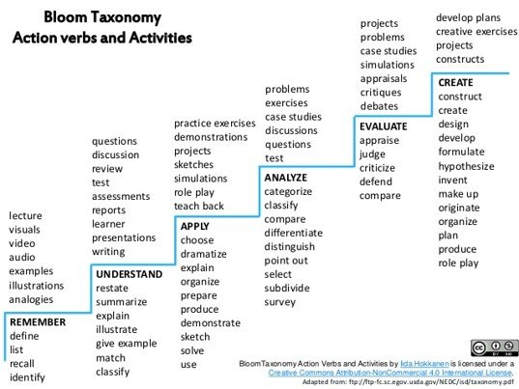
Bloom’s Taxonomy: Cognitive Domain: Action Verb

Slide 82
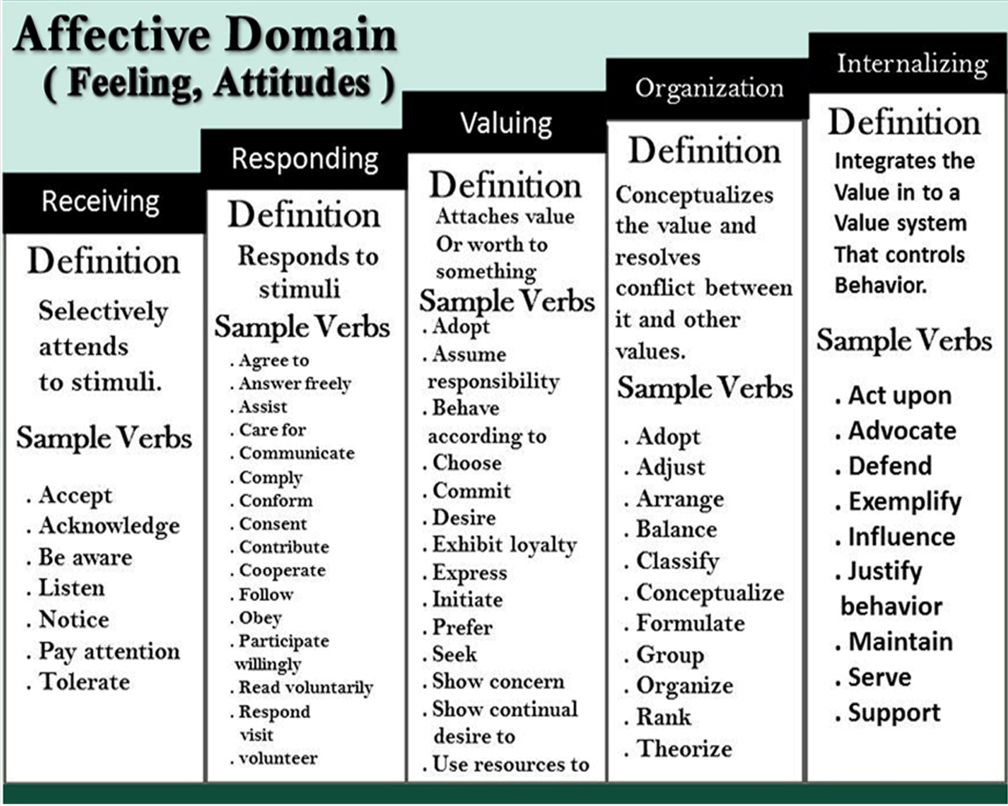
Bloom’s Taxonomy: Affective Domain: Action Verb

Slide 83
Bloom’s Taxonomy: Affective Domain: Action Verb

Slide 84
Program Educational Objective (PEO)
PEOs are broad statements that describe the carrier and professional accomplishments in four to five years after graduation that the program is preparing graduates to achieve.
These are brief, clear statements that describe the desired outcomes of instruction, i.e., the specific skills, values, and attitudes students should exhibit that reflect the broader objectives.
Program Educational Objectives (PEOs) should be defined by the Head of the Department in consultation with the faculty members.
PEOs must follow from the mission of the department.
PEOs are a promise by the department to the aspiring students about what they will achieve once they join the programme.

Slide 85
Program Educational Objective (PEO)
PEOs can be written from different perspectives like Career, Technical Competency and Behaviour.
While writing the PEOs do not use the technical terms as it will be read by prospective students who wants to join the programme.
Three to five PEOs are recommended.
There are three types of educational objectives, which reflect different aspects of student learning:
Cognitive Objectives: “What do you want your graduates to know?”
Affective Objectives: “What do you want your graduates to think or care about?”
Behavioral Objectives: “What do you want your graduates to be able to do?”

Slide 86
Program Educational Objective (PEO)
Learning Objectives can also reflect in different levels:
Mastery Objectives: These are typically concerned with the minimum performance essentials-those learning tasks/skills that must be mastered before moving on to the next level of instruction.
Developmental Objectives: These are concerned with more complex learning outcomes-those learning tasks on which students can be expected to demonstrate varying degree of progress.
Instructional Objectives: These describe in detail the behaviors that students will be able to perform at the conclusion of a unit of instruction such as a class, and the conditions and criteria which determine the acceptable level of performance.

Slide 87
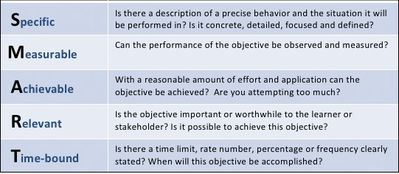
Program Educational Objective (PEO)

Slide 88
Program Educational Objective (PEO)
Writing Objectives: A.B.C.D. Method
One method that can be useful when writing a learning objective or outcome is the A. B. C. D. method (Heinich, et al., 1996). This method considers:
Audience: Who are your learners (who will be doing the performance)?
Behavior: Describe the task or behavior using action verbs -- be sure it is something that can be heard or something that is observable.
Conditions: Under what conditions (what tools, aids or reference materials can the learner use? Are there things that they will not be able to use?)
Degree: To what degree of mastery -- how well must it be done (speed, accuracy, quality, etc.)?

Slide 89
Program Educational Objective (PEO)
Examples of Learning Objectives using the A.B.C.D. Method.
Below are some example objectives which include-
Audience (A), Behavior (B), Condition (C), and Degree of Mastery (D).
Audience (A): Who is performing the action?
Behavior (B): What will the student be able to do? [Use Bloom’s taxonomy & action verb that describe an accomplishment that is measurable]
Condition (C): Give the conditions under which the performance will occur. Be specific.
Degree of Mastery (D): Describe the minimum criteria for acceptable student performance. (Optional).

Slide 90
Program Educational Objective (PEO)
Students will explain the social responsibility to ensure that adequate legal services are provided to those who cannot afford to pay for them in three paragraphs.
Students will describe the steps in planning factual investigation in legal research, including identifying and formulating relevant legal theories, generating alternative solutions and strategies, applied to a hypothetical case.
Following Completion of the science program, the student will plot a quadratic equation using a graphing Calculator in two minutes or less.
Students will design solutions to the complex problems applying technical competence in the field of Electronics and Communication Engineering.
Students will engage in designing, manufacturing, testing, operating and /or maintaining systems in the field of electrical and electronics engineering and allied engineering industries.

Slide 91
Program Educational Objective (PEO)
Student will solve problems of social relevance applying the knowledge of electrical and electronics engineering, and/or pursue higher education and research.
Student will work effectively as individuals and as team members in multidisciplinary projects.
Student will engage in lifelong learning, career enhancement and adopt to changing professionals and societal needs applying the knowledge of electrical and electronics engineering.

Slide 92
Program Educational Objective (PEO)
Examples of Academic Program Educational Objective
The academic program educational objectives are organized in four broad areas:
1) contextualization of knowledge; 2) praxis and technique; 3) critical thinking; and, 4) research and communication.
Contextualization of Knowledge
Students will…
identify, formulate and solve problems using appropriate information and approaches.
demonstrate their understanding of major theories, approaches, concepts, and current and classical research findings in the area of concentration.
apply knowledge of mathematics, chemistry, physics, and materials science and engineering principles to materials and materials systems.
demonstrate an understanding of the basic biology of microorganisms.

Slide 93
Program Educational Objective (PEO)
Praxis and Technique
Students will…
utilize the techniques, skills and modern tools necessary for practice.
demonstrate professional and ethical responsibility.
appropriately apply laws, codes, regulations, architectural and interiors standards that protect the health and safety of the public.
Critical Thinking
Students will…
recognize, describe, predict, and analyze systems behavior.
evaluate evidence to determine and implement best practice.
examine technical literature, resolve ambiguity and develop conclusions.
synthesize knowledge and use insight and creativity to better understand and improve systems.

Slide 94
Program Educational Objective (PEO)
Research and Communication
Students will…
retrieve, analyze, and interpret the professional and lay literature providing information to both professionals and the public.
propose original research: outlining a plan, assembling the necessary protocol, and performing the original research.
design and conduct experiments, and analyze and interpret data.
write clear and concise technical reports and research articles.
communicate effectively through written reports, oral presentations, and discussion.
guide, mentor and support peers to achieve excellence in practice of the discipline.
work in multi-disciplinary teams and provide leadership on materials-related problems that arise in multi-disciplinary work.

Slide 95
Program Outcomes (POs)
Program Outcomes (POs) are clear, concise statements that describe how students can demonstrate their mastery of program goals (Allen, M., 2008).
These statements identify the knowledge, skills, or attitudes that students will be able to demonstrate, represent, or produce upon successful completion of the program.
POs are to be in line with the graduate attributes as specified in the Washington Accord.
POs are to be specific, measurable, and achievable.
NBA has defined 12 POs and you need not define those POs by yourself, and it is common for all the institutions in India.
As per Washington Accord: POs are statements that describe what the students graduating from engineering programs should be able to do at the time of graduation.
In the syllabus book given to students, there should be clear mention of course objectives and course outcomes along with CO-PO course articulation matrix for all the courses.

Slide 96
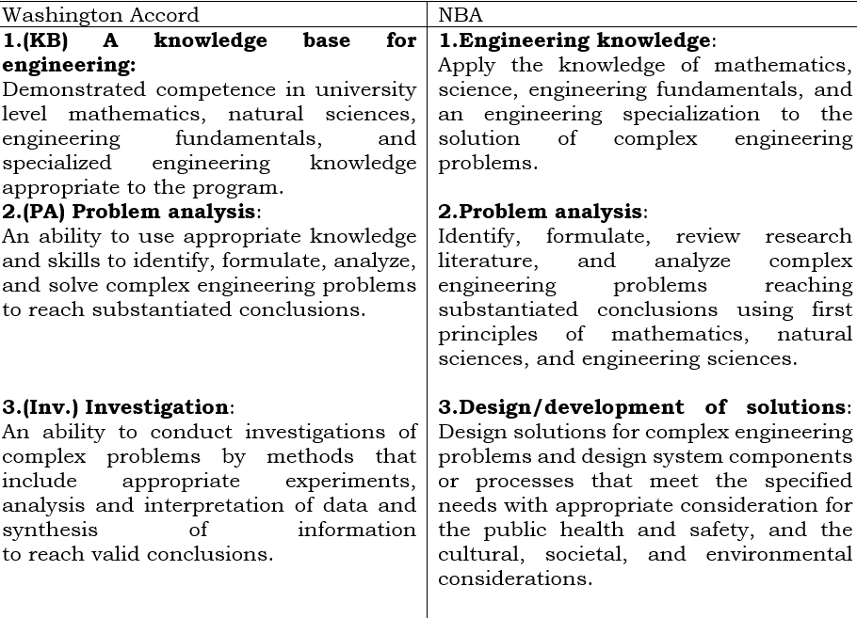
Program Outcomes (POs)

Slide 97
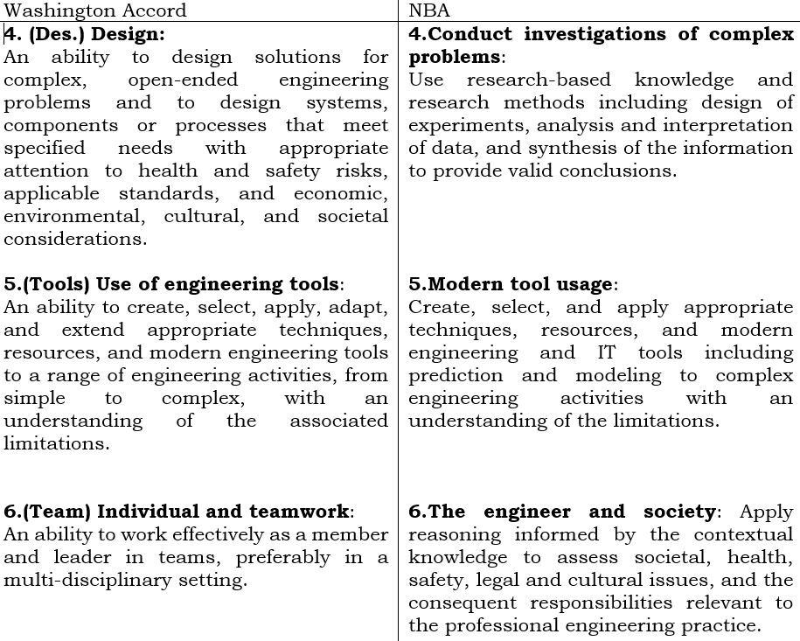
Program Outcomes (POs)

Slide 98
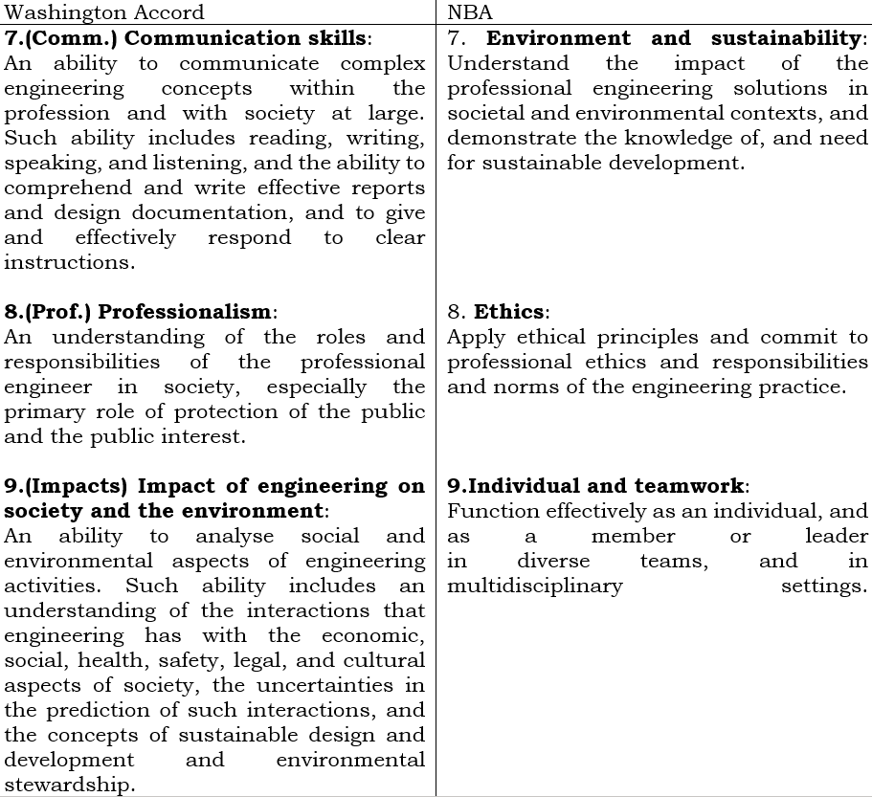
Program Outcomes (POs)

Slide 99
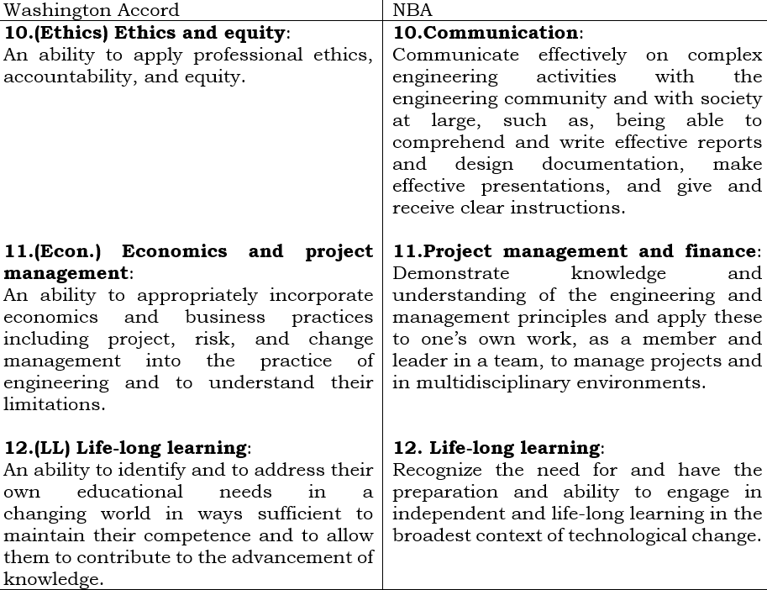
Program Outcomes (POs)

Slide 100
Program Outcomes (POs)
The first thing that we do we classify the POs into two categories:
A: Disciplinary outcomes: 5 numbers of POs [PO1-PO5]
B: Generic Outcomes or professional outcomes: 7 numbers of POs [PO6-PO12]
3 POs- Complex Engineering Problem (PO1, PO2 & PO3),
2 POs-Complex Engineering activities (PO4 & PO5)
2 POs- Contextual Knowledge, (PO6, PO7)

Slide 101
Program Outcomes (POs)
Complex Engineering Problem:
Involve wide-ranging or conflicting technical engineering and other issues.
Have no obvious solutions like end of the chapter problems.
Involve diverse groups of stakeholders with widely varying needs.
Have significant consequences in a range of contexts.
Have many component parts and sub-problems to be addressed.

Slide 102
Program Outcomes (POs)
Examples of Some Complex Engineering Problems:
Plan for supplying water for irrigation and drinking to a group of villages in an arid zone.
Design and instrumentation system for managing available water and its utilization in a river basin.
Design a system for the construction of large-scale poor and middle-class housing in towns with population less than two lakhs.
Improve the quality of power supply to a city or a district.
Design a system for managing an elephant corridor without conflict between humans and elephants.

Slide 103
Program Outcomes (POs)
Complex Engineering Activities:
They involve the use of diverse resources (people, money, equipment, materials, information. and technologies).
They require resolution of significant problems arising from the interaction between wide-ranging and conflicting technical, engineering, and other issues.
They involve creative use of knowledge and engineering principles.
They can extend beyond the previous experiences.

Slide 104
Program Outcomes (POs)
1.Engineering knowledge:
Apply the knowledge of mathematics, science, engineering fundamentals, and an engineering specialization to the solution of complex engineering problems.
What are the activities we can have for PO?
Solve end of the chapter problems that is a minimum one should do.
Understand the context in which a given engineering problem was formulated or understand the nature of some complex engineering problems.
Give some examples of complex engineering problems,
Give multiple solutions to given complex engineering problems, once again, you do not have to solve it, you just make available multiple solutions that there are no generally unique solutions to complex engineering problems.

Slide 105
Program Outcomes (POs)
2.Problem analysis: Identify, formulate, review research literature, and analyze complex engineering problems reaching substantiated conclusions using first principles of mathematics, natural sciences, and engineering sciences.
What are the activities we can have for PO?
Identify complex problems that dominantly belong to your engineering branch.
Make appropriate assumptions, especially about the context in which the solutions are being sought that helped formulate an identified complex engineering problem
Justify the assumptions made in formulating a complex engineering problem based on survey of the related literature and these assumptions should be reviewed by the concerned stakeholders or at least a group of people will have to review whether those assumptions made are appropriate or not.
Understand the requirements of end-users of solutions to the problem.
Explore and select a method of solving a formulated problem.
Specify the hardware or software products and processes that the solution to the formulated engineering problem

Slide 106
Program Outcomes (POs)
3.Design/development of solutions: Design solutions for complex engineering problems and design system components or processes that meet the specified needs with appropriate consideration for the public health and safety, and the cultural, societal, and environmental considerations.
What are the activities we can have for PO?
Understand the role of public health and safety and the cultural, societal, and environmental considerations in determining the non-functional requirements of products and processes.
Identify the standards that are applicable to the product or process that needs to be designed and developed.
Design components and subsystems as per specifications.
Specify the testing process to check the performance of the design product or process.
Document the design of products, components, and processes.

Slide 107
Program Outcomes (POs)
4.Conduct investigations of complex problems:
Use research-based knowledge and research methods including design of experiments, analysis and interpretation of data, and synthesis of the information to provide valid conclusions.
What are the activities we can have for PO?
Plan and perform experiments or surveys and collect the data in accordance with the applicable standards.
Perform the necessary calculation and data reduction to draw valid conclusions.
Present the results in a professional manner

Slide 108
Program Outcomes (POs)
5.Modern tool usage:
Create, select, and apply appropriate techniques, resources, and modern engineering and IT tools including prediction and modeling to complex engineering activities with an understanding of the limitations.
What are the activities we can have for PO?
Determine the requirements of a simulation tool for a class of engineering problems - that can be one of the exercises.
Create tools for simulation and solving a class of engineering problems - creating such tools can be done as a project.
Select the most cost-effective tool from the commercially available Engineering and IT tools for addressing a class of engineering problems.
Understand the limitations of given engineering or IT tool.
Use the engineering IT tools made available by the department.

Slide 109
Program Outcomes (POs)
6.The engineer and society:
Apply reasoning informed by the contextual knowledge to assess societal, health, safety, legal and cultural issues, and the consequent responsibilities relevant to the professional engineering practice.
What are the activities we can have for PO?
Understand the goals and working of relevant professional society.
Identify when and where engineers interact with society through their professional activities.
Understand the responsibilities implied in one's professional practice.

Slide 110
Program Outcomes (POs)
7. Environment and sustainability:
Understand the impact of the professional engineering solutions in societal and environmental contexts, and demonstrate the knowledge of, and need for sustainable development.
What are the activities we can have for PO?
Understand what sustainable growth is;
Understand the impact of given technology and environment and sustainability.
Analyze the impact of a given engineering solution on environment and sustainability.

Slide 111
Program Outcomes (POs)
8. Ethics:
Apply ethical principles and commit to professional ethics and responsibilities and norms of the engineering practice.
The application of ethical principles to commit to professional ethics and responsibilities and norms of engineering practice requires moral autonomy.
What are the activities we can have for PO?
Identify the deviations of an engineering solution from the accepted professional practices.
Identify the impact of an engineering solution on different groups of persons.
Recognize the ethical dilemma in the case study presented.
Propose actions that minimize damage and synthesize solutions rather than judge the players in ethically complex situations presented as case studies.

Slide 112
Program Outcomes (POs)
9.Individual and teamwork:
Function effectively as an individual, and as a member or leader in diverse teams, and in multidisciplinary settings.
What are the activities we can have for PO?
Group assignments that involve group decision making, division of work through negotiation.
Group projects.
Co-curricular activities
Activities through e-groups.

Slide 113
Program Outcomes (POs)
10.Communication:
Communicate effectively on complex engineering activities with the engineering community and with society at large, such as, being able to comprehend and write effective reports and design documentation, make effective presentations, and give and receive clear instructions.
What are the activities we can have for PO?
Write technical documents that get evaluated as per declared rubrics.
Make short presentations to peers and lay persons that get evaluated as per declared rubrics.
Give feedback on a presented activity - even giving feedback can be practiced by the students.
Document the feedback given on presented activity.
Encourage and support group members in meeting the goals.

Slide 114
Program Outcomes (POs)
11.Project management and finance:
Demonstrate knowledge and understanding of the engineering and management principles and apply these to one’s own work, as a member and leader in a team, to manage projects and in multidisciplinary environments.
What are the activities we can have for PO?
Offer a course on engineering management and/or Project Management.
Do well orchestrated mini and major projects.
Determine the time and financial resources required to implement a project.
Analyze the performance of an organization for example, from its balance sheet.

Slide 115
Program Outcomes (POs)
12. Life-long learning:
Recognize the need for and have the preparation and ability to engage in independent and life-long learning in the broadest context of technological change.
What are the activities we can have for PO?
Determine the knowledge, skills and attitudes needed at the beginning of a project.
That is writing a report and/or developing a product or process.
Develop strategies to acquire the required knowledge and skills.
Acquire the required knowledge and skills outside classroom.
Participate in professional development, professional society and also in co-curricular and extracurricular activities.

Slide 116
Program Specific Outcomes (PSOs)
Programs Specific Outcomes (PSO) represent what the students should be able to do at the time of graduation from a specific program.
Characteristics of PSO Statements:
1)The PSO statement should start with one or more action verbs.
Creating-compose, construct, create, design, develop, integrate, invent, make, manage, modify, prepare, propose, synthesize
Evaluating-assess, choose, convince, critique, decide, determine, defend, estimate, judge, justify, measure, predict, prioritize, prove, rate, recommend, select
Analyzing-analyze, categorize, compare, contrast, deconstruct, differentiate, examine, infer, organize, select, test

Slide 117
Program Specific Outcomes (PSOs)
Characteristics of PSO Statements:
Applying-apply, carry out, choose, demonstrate, recreate, show, solve, use
Understanding-describe, distinguish, clarify, classify, compare, convert, contrast, estimate, explain, identify, locate, predict, relate, report, restate, translate, summarize
Remembering-define, describe, identify, label, list, match, name, order, recall, recognize
2) The action verbs should be followed by clearly identified technical objects related only to the program of concern and if required by the conditions under which the actions must be performed.
3) Curriculum of a program is derived from POs and PSOs.

Slide 118
Program Specific Outcomes (PSOs)
Characteristics of PSO Statements:
4) PSOs are program specific, 2 to 4 in numbers, and need to be defined following a well-documented process.
5) PSOs should only imply the core courses of the program. There should not directly address any of the electives of the program.
6) The curricular gaps should not be there in PSOs, because it is supposed to come from PSOs
7) In the PSO statement, the words like “such as” or ‘like’, “etcetera,” and “various” should not be used.
8) PSO statement should not be POs reworded in the context of discipline of the program.

Slide 119
Program Specific Outcomes (PSOs)
Characteristics of PSO Statements:
[Example-
Understand modern management and construction techniques (PO11 words) to complete the projects within the stipulated period and funds.
Apply the knowledge of mathematics, science, engineering fundamentals (PO1 words) to the solution of problems of computer science and engineering.]

Slide 120
Program Specific Outcomes (PSOs)
Samples of PSO: Civil Engineering:
PSO1: Survey, map and plan layouts for building structures and alignments for canals and roads.
PSO2: Specify design supervised test and evaluate foundations and super structures for residences, public buildings, industries, irrigation structures, power houses, highways, railways, airways, docks, and harbours.
PSO3: Analyze water resources, hydrological systems to estimate safe and assured withdrawals and specify, design, and evaluate water conveying systems, hydraulic machines, and surge systems.
PSO4: Specify, select, and formulate environmental engineering systems.

Slide 121
Program Specific Outcomes (PSOs)
Samples of PSO: Electronics & Communication Engineering:
PSO1: Specify, design, prototype and test modern electronic systems that perform analog and digital processing functions as per user requirements using currently available electronic components.
PSO2: Architect, partition and select appropriate technologies for implementation of a specified communication systems like wired and wireless/RF communication systems.
PSO3: Ability to design the Embedded systems of Electronics & Communication Engineering using advanced hardware and software tools with analytical skills to achieve the Societal needs.
PSO4: Knowledge of social & environmental awareness along with ethical responsibility to achieve a successful career addresses the real-world applications using optimal resources as an entrepreneur.

Slide 122
Course Outcomes (COs)
Course Outcomes are what the student should be able to do at the end of a course. It is an effective ability, including attributes, skills, and knowledge to successfully carry out the identified activity.
For a CO, there are two extremely important features, it should be observable, and it should be measurable.
Number of CO should be depending on number of Units in a particular Course. It should not be more than 6.
Autonomous institutions / Universities are not required to follow the unit structure and may have the number COs as decided by the course content and the teacher.
Structure of a CO statement:
There are four fields, action, knowledge, condition and criteria.
Among these four, the first two are mandatory. Every CO statement must have an action part and a knowledge part.
The other two condition and criteria are optional.

Slide 123
Course Outcomes (COs)
Structure of a CO statement:
Action: It represents a cognitive, affective or psycho motor activity, the level should perform. The action is indicated by an action verb. Occasionally, two action verbs are also used. These action verbs represent the cognitive process or processes concerned.
[An example for that can be draw Bode plots for the given dynamic system and determine the gain and phase margins. Both are important activities.]
Knowledge: knowledge which represents the specific knowledge from any one or more of the eight knowledge categories.
Condition: Condition represents the process; the learner is expected to follow are the condition under which to perform the action.
Criteria: Criteria represent the parameters that characterize the acceptability levels of performing the action. Obviously, it must be a correct action that is not what is implied by the criteria.

Slide 124
Course Outcomes (COs)
Sample 1: Student will be able to:
Calculate major and minor losses associated with fluid flow in piping networks.
Action: Calculate (Cognitive Process-Apply)
Knowledge: major and minor losses associated with fluid flow in piping networks (This would be both conceptual knowledge and proceeded knowledge.)
Condition: None
Criteria: None

Slide 125
Course Outcomes (COs)
Sample 2: Student will be able to:
Determine the dynamic unbalanced the conditions of a given mechanical system of rigid bodies subjected to force and acceleration.
Action: Determine (Cognitive Process-Apply)
Knowledge: dynamic unbalanced the conditions (This would be both conceptual knowledge and procedural knowledge.)
Condition: given mechanical system of rigid bodies subjected to force and acceleration.
Criteria: None

Slide 126
Course Outcomes (COs)
Sample 3: Student will be able to:
Understand the effect of all the parameters in voltage-controlled oscillators through simulation using TINA TI.
Action: Understand (Cognitive Process-Understand)
Knowledge: effect of all the parameters in voltage-controlled oscillators (This would be Conceptual knowledge.)
Condition: simulation using TINA TI.
Criteria: None

Slide 127
Course Outcomes (COs)
Sample 4: Student will be able to:
Determine the root of the given equation, accurate to second decimal place using Newton-Raphson method.
Action: Determine (Cognitive Process-Apply)
Knowledge: root of the given equation (This would be both conceptual knowledge and procedural knowledge.)
Condition: using Newton-Raphson method.
Criteria: accurate to second decimal place.

Slide 128
Course Outcomes (COs)
Course Name: Analog Electronic Circuits; Course Code: EC 402; Contact: 3:0:0 Total Contact Hours: 36; Credits: 3
Course Outcome:
Students will be able to:
CO1: model a transistor amplifier circuit in audio frequency range with the help of h-parameter model.
CO2: understand concept of feedback in amplifier and classify amplifiers based on feedback topology.
CO3: Implement signal generator circuit in both audio frequency and radio frequency range using transistor.
CO4: design power amplifier circuit in audio frequency range.
CO5: design and analyse linear and nonlinear electronic circuits using OPAMP (I.C-741).

Slide 129
Mapping of Course Outcomes (COs)
The action verb enables you to tag the CO with the cognitive level.
We can use for simplicity's sake, the acronyms R-Remember, U-Understand, Ap-Apply, An-Analyze, E-Evaluate and C-Create.
Occasionally we have seen that a CO may have two action verbs then it is tagged by two cognitive levels.
There is no sharp demarcation line between some cognitive levels; there is a possibility of one action verb representing two different cognitive levels. So, one needs to use judgement in such cases.
COs must be tagged with knowledge categories. It would be helpful in designing an appropriate instruction.

Slide 130
Course Outcomes (COs)
Most of the Courses are strongly Matched with PO1.
It is possible that PO2, PO3, PO4 and PO5 are addressed slightly by some courses.
Some specific courses that address PO6, PO7, PO8, PO9, PO10 &PO11- engineering society, environment and sustainability, ethics, teamwork, projects, management and finance, communication .
Projects can potentially address many POs. But the POs addressed must get reflected in the rubrics used to evaluate the projects.
Tagging a CO with any PO requires that both instruction and assessment include items related to that identified PO.
If a CO is tagged with PO12, (PO12 is lifelong learning) we must show instructional activities design to facilitate learners acquire the knowledge skills and attitudes required for lifelong learning.

Slide 131
Mapping of Course Outcomes (COs)
COs |  | PO/PSO | CL | KC | Class session | Lab Session
CO1 | Model transistor amplifier circuit in audio frequency range with the help of h-parameter model. | PO1, PO10/ PSO1 | U | C,P | 9 | 4
CO2 | Understand concept of feedback in amplifier and classify amplifiers based on feedback topology. | PO1/ PSO1 | U | C,P | 6 | 4
CO3 | Design and analyze signal generator circuit in both audio frequency and radio frequency range using transistor. | PO3, PO4, PO5/ PSO1 | AP, An | C,P | 8 | 4
CO4 | Design and analyze power amplifier circuit in audio frequency range. | PO3, PO4, PO5/ PSO1 | AP, An | C,P | 10 | 4
CO5 | Design and analyze linear and nonlinear electronic circuits using OPAMP (I.C-741). | PO3, PO4, PO5/ PSO1 | AP, An | C,P | 3 | 5
 |  |  |  |  | 36 | 28

Slide 132
Mapping of Course Outcomes (COs) with Program Outcomes (POs)
CO | PO1 | PO2 | PO3 | PO4 | PO5 | PO6 | PO7 | PO8 | PO9 | PO10 | PO11 | PO12
CO1 | 3 | 3 | 3 | 3 | 2 | - | 2 | 1 | 3 | - | 1 | 3
CO2 | 3 | 3 | 3 | 3 | 2 | 1 | 2 | - | 3 | 2 | 1 | 3
CO3 | 3 | 3 | 3 | 3 | 2 | - | 2 | - | 3 | - | 1 | 3
CO4 | 3 | 3 | 3 | 3 | 2 | 2 | 2 | 1 | 3 | 1 | - | 3
CO5 | 3 | 3 | 3 | 3 | 2 | - | 2 | - | 3 | 1 | 1 | 3
3-High; 2-Moderate; 1-Low

Slide 133
Mapping of Course Outcomes (COs) with Program Specific Outcomes (PSOs)
CO | PSO1 | PSO2 | PSO3
CO1 | 3 | 2 | 1
CO2 | 3 | 2 | 1
CO3 | 3 | 2 | 1
CO4 | 3 | 2 | 3
CO5 | 3 | 3 | 3
AVERAGE | 3 | 2.2 | 1.8
3-High; 2-Moderate; 1-Low

Slide 134
Some questions in different cognitive levels of Bloom’s Taxonomy
Remembering Level:
What happened after...?
How many...?
What is...?
Who was it that...?
Can you name ...?
Find the meaning of…
Describe what happened after…
Who spoke to...?
Which is true or false...?

Slide 135
Some questions in different cognitive levels of Bloom’s Taxonomy
Understanding Level:
Can you write in your own words?
How would you explain…?
Can you write a brief outline...?
What do you think could have happened next...?
Who do you think...?
What was the main idea...?
Can you clarify…?
Can you illustrate…?
Does everyone act in the way that …….. does?

Slide 136
Some questions in different cognitive levels of Bloom’s Taxonomy
Applying Level:
Do you know of another instance where…?
Can you group by characteristics such as…?
Which factors would you change if…?
What questions would you ask of…?

Slide 137
Some questions in different cognitive levels of Bloom’s Taxonomy
Analyzing Level:
Which events could not have happened?
If. ..happened, what might the ending have been?
How is...similar to...?
What do you see as other possible outcomes?
Why did...changes occur?
Can you explain what must have happened when...?
What are some or the problems of...?
Can you distinguish between...?
What were some of the motives behind..?

Slide 138
Some questions in different cognitive levels of Bloom’s Taxonomy
Evaluating Level:
Is there a better solution to...?
Judge the value of... What do you think about...?
Can you defend your position about...?
Do you think...is a good or bad thing? Who will gain & who will loose?
How would you have handled...?
What changes to.. would you recommend?
Do you believe...? How would you feel if. ..?
How effective are. ..? What are the alternatives?
What are the consequences..? What are the pros and cons of....?
What influence will....have on our lives?

Slide 139
Some questions in different cognitive levels of Bloom’s Taxonomy
Creating Level:
Can you design a...to...?
Can you see a possible solution to...?
If you had access to all resources, how would you deal with...?
Why don't you devise your own way to...?
What would happen if ...?
How many ways can you...?
Can you create new and unusual uses for...?
Can you develop a proposal which would...?

Slide 140
Types of Assessment Process:
Direct Assessment:
1.Formative Assessment [Cumulative Internal Examination (CIE):
Assignment, Quiz, Slot Test, Report writing, Power point presentation, GD]
2. Summative Assessment [Semester End Examination (SEE)]
Indirect Assessment:
Feedback from the Stake holders

Slide 141
Type of the Questions for Direct Assessment:
Recall: Remembering & Understanding Type
Application Type
Logical: Analytical Type
Design type: Evaluation & Creation

Slide 142
Type of Questions | Suggested Range (%)
Recall: Remembering & Understanding Type | 30-50
Application Type | 20-30
Logical: Analytical Type | 25-30
Evaluation Type | 5-10
Design type: Creation
Total | Average: 100
Marks Distribution among the type of Questions for Direct Assessment:

Slide 143
Question Mapping with Course Outcome (CO), Cognitive Level (CL) Knowledge domain (KD)
Module Number | Sl No. | Question | Marks | CO | Type (based on CL) | KD | Answer

Slide 144
Process for Measuring the Attainment of COs, POs and PSOs

Slide 145
Procedure for CO attainment
CO attainment should be obtained through Cumulative Internal Examination (CIE) and Semester End Examination (SEE)
Attainment Level for EC502
Target level 1: 60% students must score 60% and above
Target level 2: 70% students must score 60% and above
Target level 3: 80% students must score 60% and above

Slide 146
CO for EC502
COs | Statement
C01 | Able to correlate the architecture , instructions, timing diagrams, addressing modes, memory interfacing, interrupts, data communication of 8085
C02 | Able to interpret the 8086 microprocessor-Architecture, Pin details, memory segmentation, addressing modes, basic instructions, interrupts
C03 | Able to Recognize 8051 micro controller hardware, input/output pins, ports, external memory, counters and timers, instruction set, addressing modes, serial data i/o, interrupts
CO4 | Able to Apply instructions for assembly language programs of 8085, 8086 and 8051
C05 | Able to Design peripheral interfacing model using IC 8255, 8253, 8251 with IC 8085, 8086 and 8051.

Slide 147
CO attainment through CIE
Distribution Question to measure CO through CIE
COs | Class test (T1) (30) | Slot test-1 (T2) (30) | Assignment (T3) (30) | Slot test-2 (T4) (30) | Quiz
CO1 | Q1,Q2, Q3 | Q1 | Q1 | - | √
CO2 | - | Q2,Q3, Q4,Q5 | Q2 | - | √
CO3 | - | - | Q3 | Q1,Q2,Q3 | √
CO4 | Q4,Q5 | Q6 | Q4 | Q4 | √
CO5 | - | - | Q5 | Q5,Q6 | √

Slide 148
CO attainment through CIE
Calculations have been made as shown in this sheet G:\Attainment Calculation\MPU\mpu.xlsx
Roll No. | Max Marks | 6 | 6 | 6 | 6 | 6 | 30 | Total Marks Attempt | Score (%) | Score or Grading in Scale of 3 (If >=60% then 3 , If >=40% but <60% then 2 , If <40% then 1) | Target >=60%
 | Course outcome | CO1 |  |  |  |  | Total Marks Obtained
 | Student Name | T1-Q1 | T1-Q2 | T1-Q3 | T2-Q1 | T3-Q1
1 | Abhimanyu Raj | 3 | 3 | 3 | 3 | 3 | 15 | 30 | 50 | 2 | N
2 | Abhirup Dey | 4 | 4 | 3 | 3 | 3 | 17 | 30 | 56.67 | 2 | N
3 | Aditya Kamlesh Shah | 5 | 4 | 5 |  | 5 | 19 | 24 | 79.17 | 3 | Y
4 | Akanksha Singh | 5 | 5 | 5 | 5 | 5 | 25 | 30 | 83.33 | 3 | Y
. | . | . | . | . | . | . | . | . | . | . | .
141 | Oindrila Choudhury | 4 | 5 | 5 | 4 | 4 | 22 | 30 | 73.33 | 3 | Y
 |  |  |  |  |  |  |  |  |  | Average Grading =2.7 | No. of (Y)=105

Slide 149
CO attainment through CIE
Calculations have been made as shown in this sheet G:\Attainment Calculation\MPU\mpu.xlsx
Summary of Calculations (Total no of students=141)
COs | Avg. grading on scale of 3 | Distribution %
 |  | % of Students whose score >60% | % of Students whose score <60% but ≥40% | % of Students whose score <40%
CO1 | 2.7 | 105/141=74.5% | 36/141=25.5% | 0/141=0%
CO2 | 2.8 | 119/141=84.4% | 22/141=15.6% | 0/141=0%
CO3 | 2.8 | 114/141=80.8% | 27/141=19.2% | 0/141=0%
CO4 | 2.7 | 95/141=67.4% | 46/141=32.6% | 0/141=0%
CO5 | 2.7 | 96/141=68.2% | 43/141=30.4% | 2/141=1.4%
CO6 | 2.8 | 101/141=71.63% | 40/141=28.36 | 0/141=0%

Slide 150
CO attainment through CIE
Calculations have been made as shown in this sheet G:\Attainment Calculation\MPU\mpu.xlsx
Summary of Calculations (Total no of students=141)
Course outcomes | % of students achieved CO | Decision on CO result (achieved) (Y/N) with level
CO1 | 74.5% | Y (Level: 2)
CO2 | 84.4% | Y(Level: 3)
CO3 | 80.8% | Y(Level:3)
CO4 | 67.4% | Y(Level:1)
CO5 | 68.2% | Y(Level: 1)
Average CO attainment for the course through CIE EC502 | 75.06% | Level: 2

Slide 151
CO attainment through SEE
80% of students score 60% marks in SEE
There fore average attainment of COs through SEE is :target level 3
This means target level 3 has been achieved through SEE
Overall CO attainment (EC502) in the scale of 3
= (40% of target level of average CO attainment through CIE) +(60% of target level of CO attainment through SEE)
[ As per NBA Tier-II example overall CO attainment =20% of CIE+80%SEE. It is also mentioned in TIER-II SAR that program may consider some other X % of CIE +Y% of SEE with due justification instead of 20% CIE +80% of SEE. In this presentation we have considered 40% of CIE +60% of SEE ]
= (40% of 2) +(60% of 3)=2.6

Slide 152
PO attainment
PO attainment should be carried out considering
(i)Direct assessment (through CIE and SEE)
(ii)Indirect assessment (Exit Student Survey, Alumni Survey, Employer Survey, Faculty Survey)

Slide 153
Co & PO MappingEC502 to PO attainment
CO | PO1 | PO2 | PO3 | PO4 | PO5 | PO6 | PO7 | PO8 | PO9 | PO10 | PO11 | PO12
EC502.1 | 3 | 3 | 2 | 2 | - | 2 | - | - | - | - | - | 3
EC502.2 | 3 | 3 | 2 | 2 | - | 2 | - | - | - | - | - | 3
EC502.3 | 3 | 3 | 2 | 2 | - | 2 | - | - | - | - | - | 3
EC502.4 | 3 | 3 | 3 | 3 | - | 2 | - | - | - | - | - | 3
EC502.5 | 3 | 3 | 3 | 3 | - | 2 | - | - | - | - | - | 3
EC 502 | 3 | 3 | 2 | 2 | - | 2 | - | - | - | - | - | 3

Slide 154
Mapping of PO with PSO
COs | PSO1 | PSO2 | PSO3
CO1 | 3 | 2 | 1
CO2 | 3 | 2 | 1
CO3 | 3 | 2 | 1
CO4 | 3 | 3 | 3
CO5 | 3 | 3 | 3
AVG OF EC502 | 3 | 2.4=2 | 1.8=2

Slide 155
Contribution of overall CO attainment of the course EC502 to PO attainment
Mapping of EC502 with POs
 | PO1 | PO2 | PO3 | PO4 | PO5 | PO6 | PO7 | PO8 | PO9 | PO10 | PO11 | PO12
EC502 | 3 | 3 | 2 | 2 | - | 2 | - | - | - | - | - | 3
The overall CO attainment of EC502 =2.6
Therefore contribution of CO attainment of EC502 to PO attainment is shown in table below .[Please Note :Following table has been generated considering mapping of CO-PO and CO attainment . For, PO1 mapping is 3 so contribution to PO1 attainment is 2.6 . Mapping with PO3 is 2 , therefore contribution to PO3 attainment is 2.6×(2/3)=1.73. Others are calculated accordingly ]
 | PO1 | PO2 | PO3 | PO4 | PO5 | PO6 | PO7 | PO8 | PO9 | PO10 | PO11 | PO12
EC502 | 2.6 (3/3)*3 | 2.6 (3/3)*3 | 1.73 (2/3)*2 | 1.73 (2/3)*2 | - | 1.73 (2/3)*2 | - | - | - | - | - | 2.6 (3/3)*3

Slide 156
PO attainment through direct assessment considering all courses
Course | PO1 | PO2 | PO3 | PO4 | PO5 | PO6 | PO7 | PO8 | PO9 | PO10 | PO11 | PO12
C101 | 1.5 | 2.3 |  | - | - | 2.5 | 2.8 | 2.1 | 1.3 | - | - | -
…
…
EC502 | 2.6 | 2.6 | 1.73 | 1.73 | - | 1.73 | - | - | - | - | - | 2.6
…
EC892 | 2.0 | 1.8 | 1.5 | 1.3 | 1.2 | 2.4 | 1.2 | 0.9 | 1.2 | 1.1 | 1.4 | 2.8
Direct Attainment | 2.1 | 2.0 | 1.8 | 1.5 | 1.2 | 2.5 | 2.6 | 2.7 | 2.4 | 1.8 | 1.9 | 2.2

Slide 157
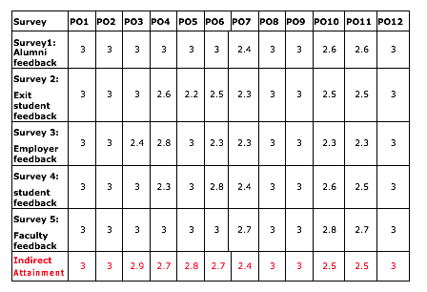
PO attainment through in-direct assessment considering all courses

Slide 158
Overall PO Attainment
Overall PO attainment = (80% of Direct attainment) + ( 20% of Indirect Attainment )
Therefore overall attainment of PO1=( 80% of 2.1)+(20% of 2.8)=2.24
Similar way other POs are calculated as shown in table below
 | PO1 | PO2 | PO3 | PO4 | PO5 | PO6 | PO7 | PO8 | PO9 | PO10 | PO11 | PO12
Direct Attainment | 2.1 | 2.0 | 1.8 | 1.5 | 1.2 | 2.5 | 2.6 | 2.7 | 2.4 | 1.8 | 1.9 | 2.2
Indirect Attainment | 2.8 | 2.5 | 2.6 | 2.7 | 1.8 | 2.1 | 2.3 | 1.9 | 1.7 | 2.4 | 2.6 | 2.8
Overall PO Attainment | 2.24 | 2.1 | 1.96 | 1.74 | 1.32 | 2.42 | 2.54 | 2.54 | 2.26 | 1.92 | 2.04 | 2.32
Target levels of POs should be defined for the Program . Target level of different POs may be different value
N.B. : If all POs are attained then Programme is running successfully context to OBE . If some POs are not attained , then action needs to be taken .

